Slide 1

Using LinkedIn to your advantage
7th June 2023

Slide 2

Today
Introduction to me
Overview of LinkedIn
Setting up your profile
Building your brand on LinkedIn
The benefits of a personal brand
Posting best practice
Q&A

Slide 3


Intro
Will Scott Enterprise Sales at Figma | Mentor, Advisor, Coach | Leading the future of work conversation
Future of work activist
Personal brand consultant
Career coach

Slide 4
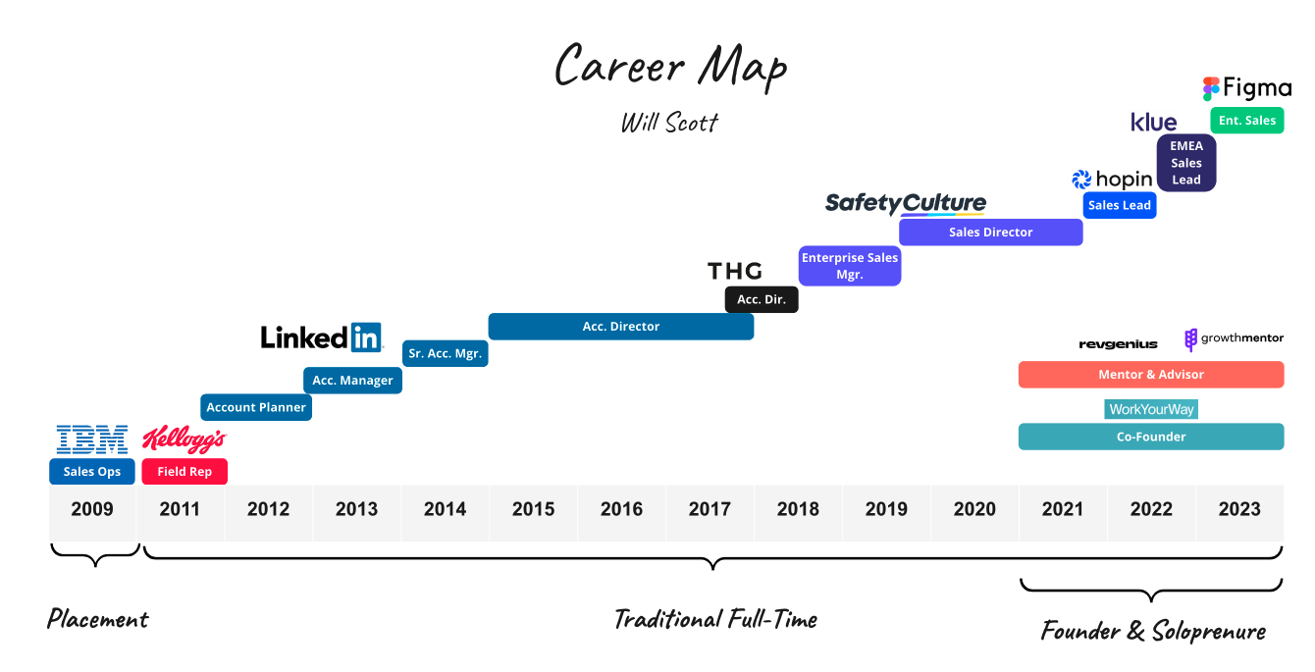

Slide 5
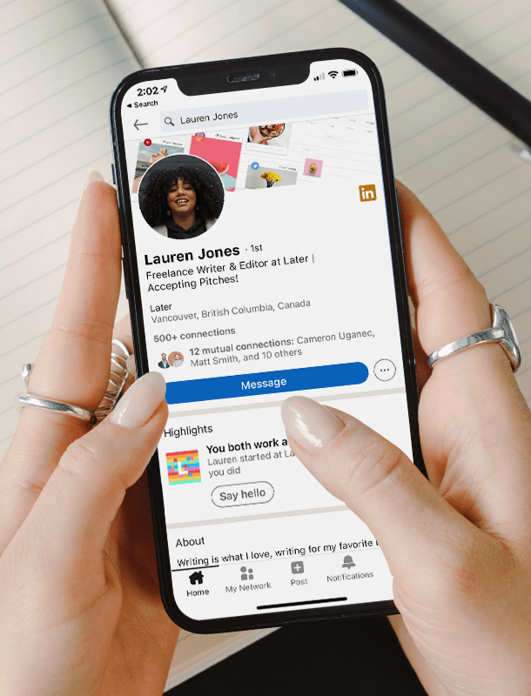
Overview of LinkedIn
The world’s largest professional network
Isn’t it just your online CV?
It’s the platform to put your best foot forward in a professional sense.
Find your next job. Business partner. Freelance opportunity. Investment. Colleague. Mentor. Conference. Friend. Reference.

Slide 6
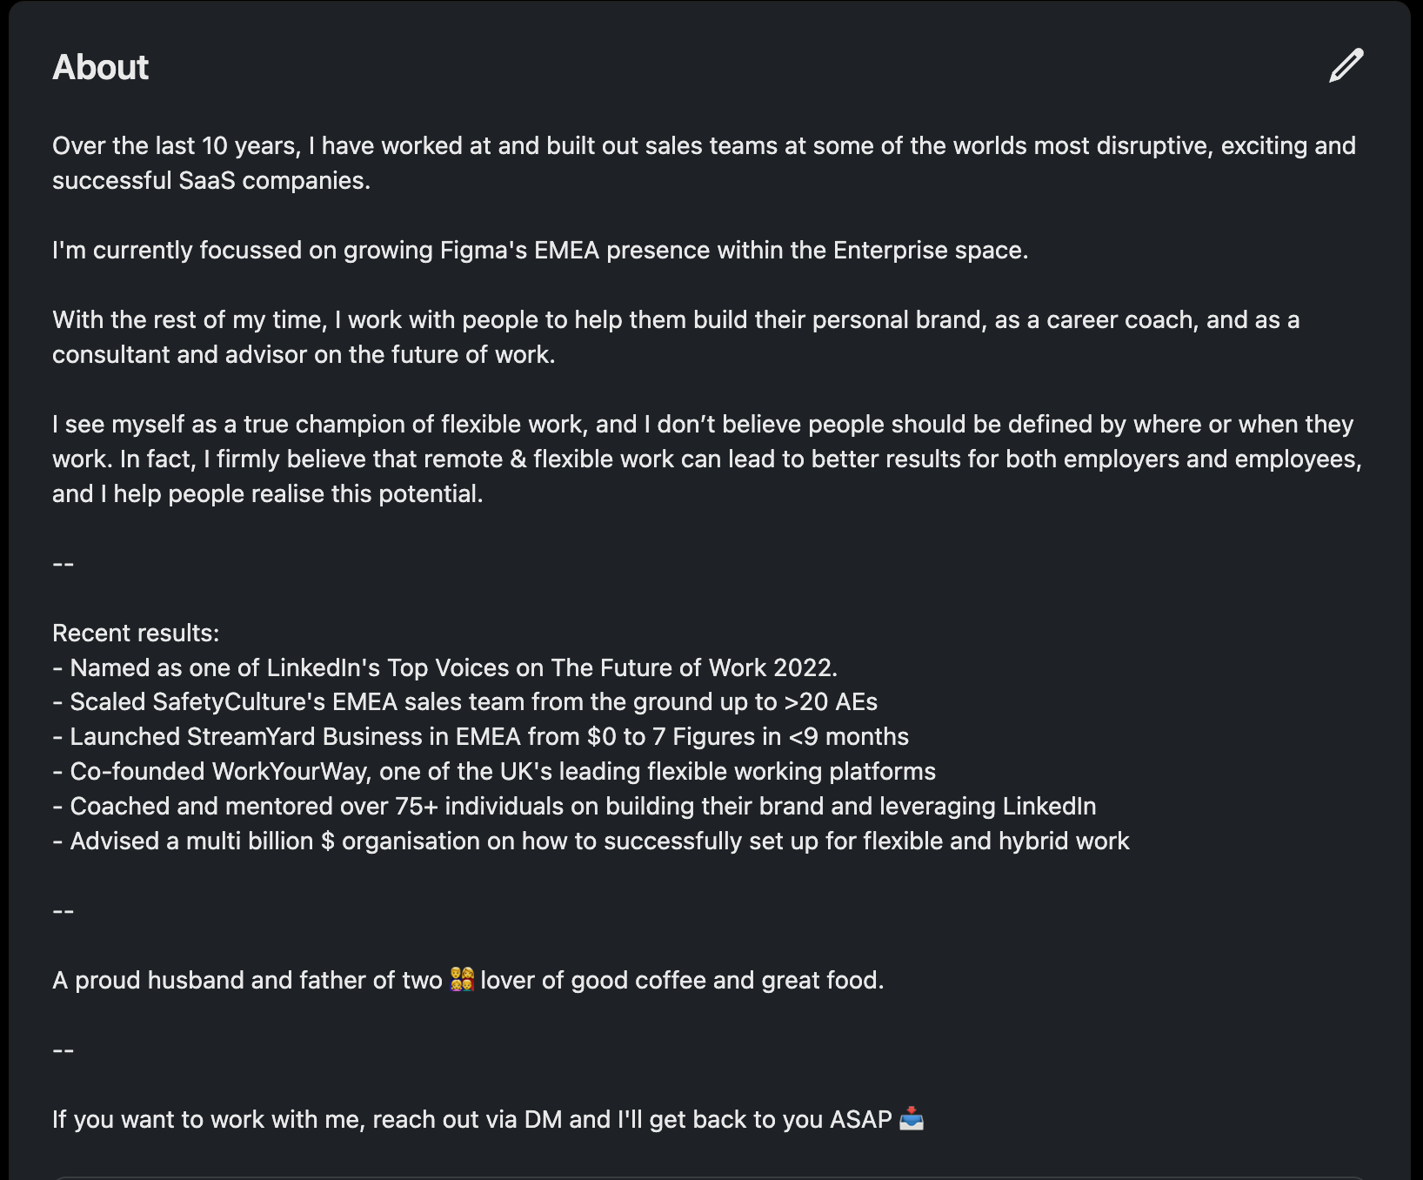
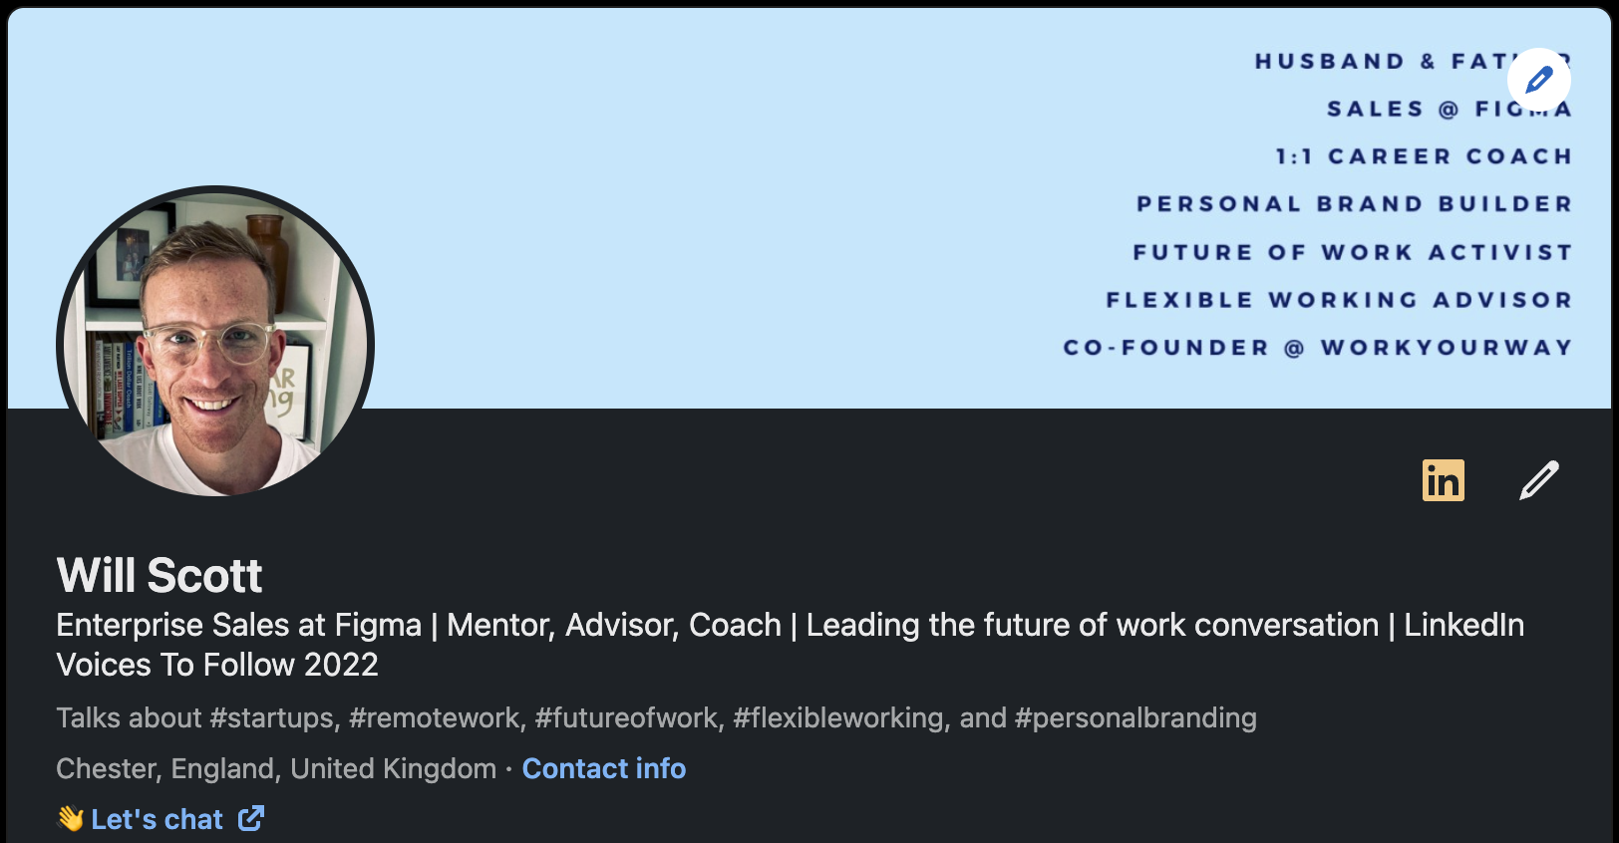
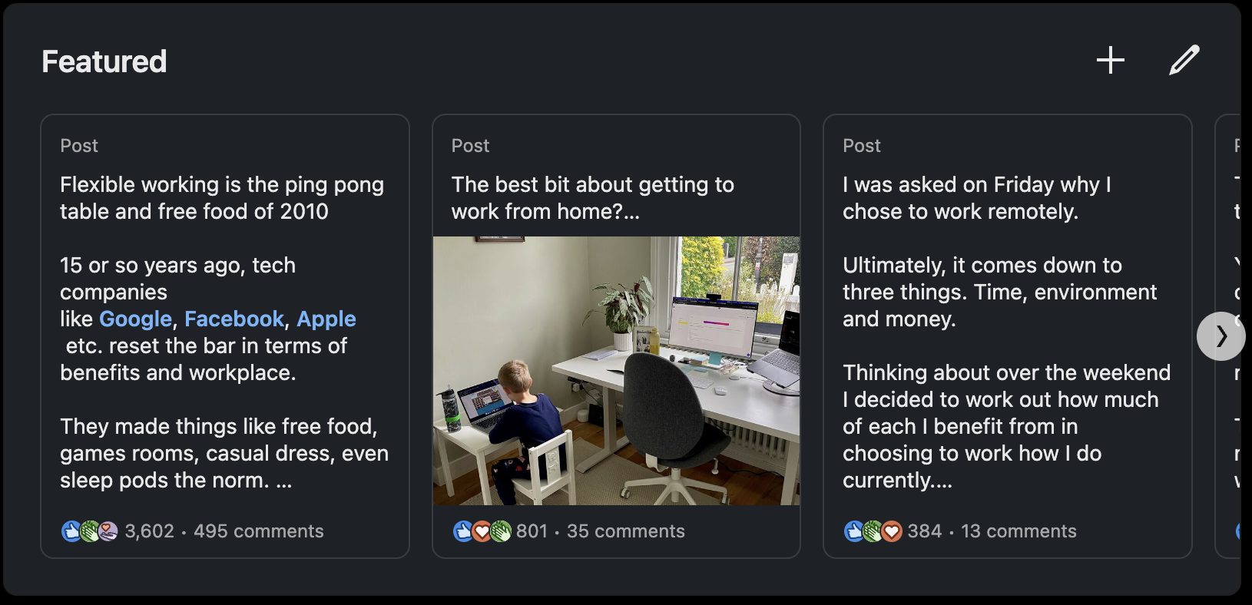
Setting up your profile
Your LinkedIn profile is
NOT
your CV
Your LinkedIn profile is
NOT
Owned by your employer

Slide 7
Building your brand on LinkedIn
Post what you want to be known for
Be authentic
Connect with others, and join the conversation
Use a format that works for you
Nothing great is built overnight, it takes time ⏳

Slide 8
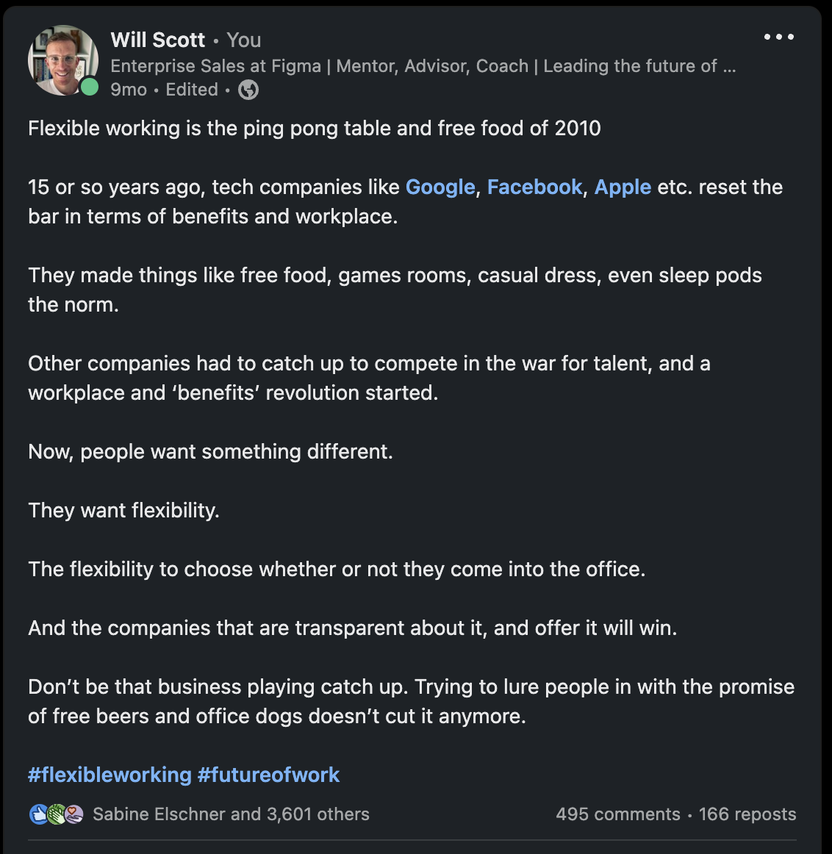
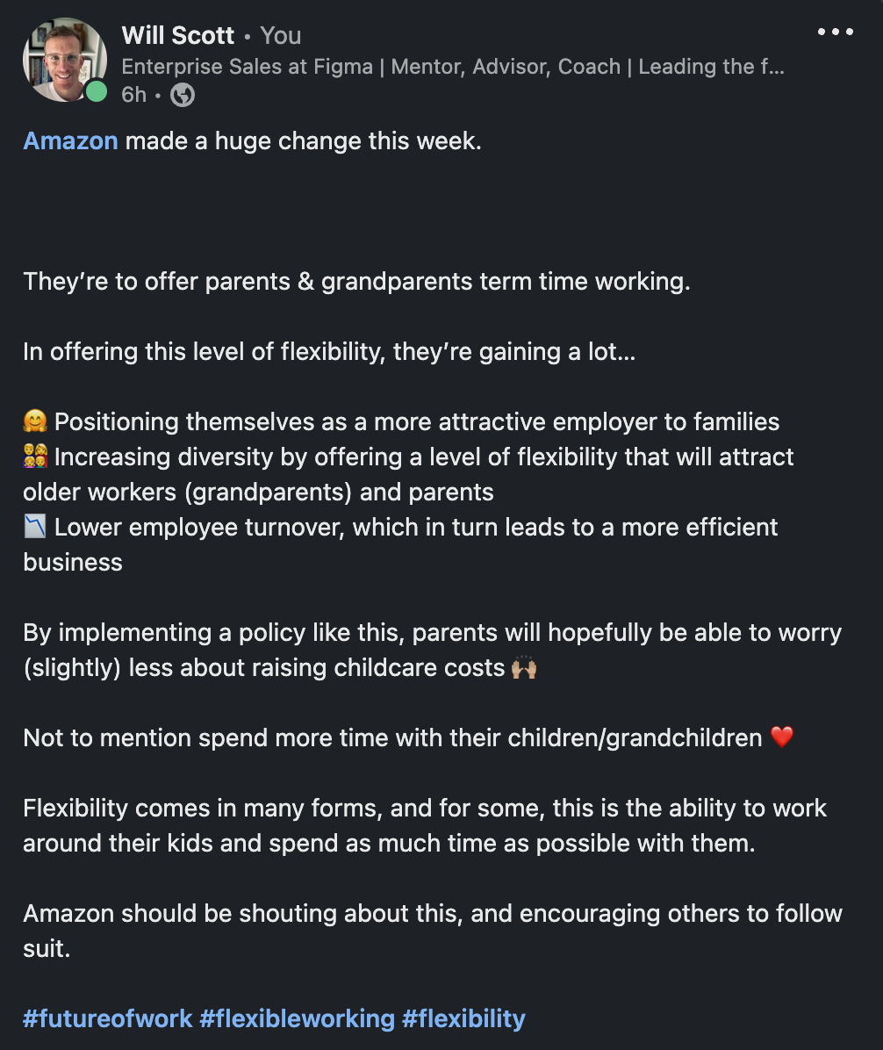
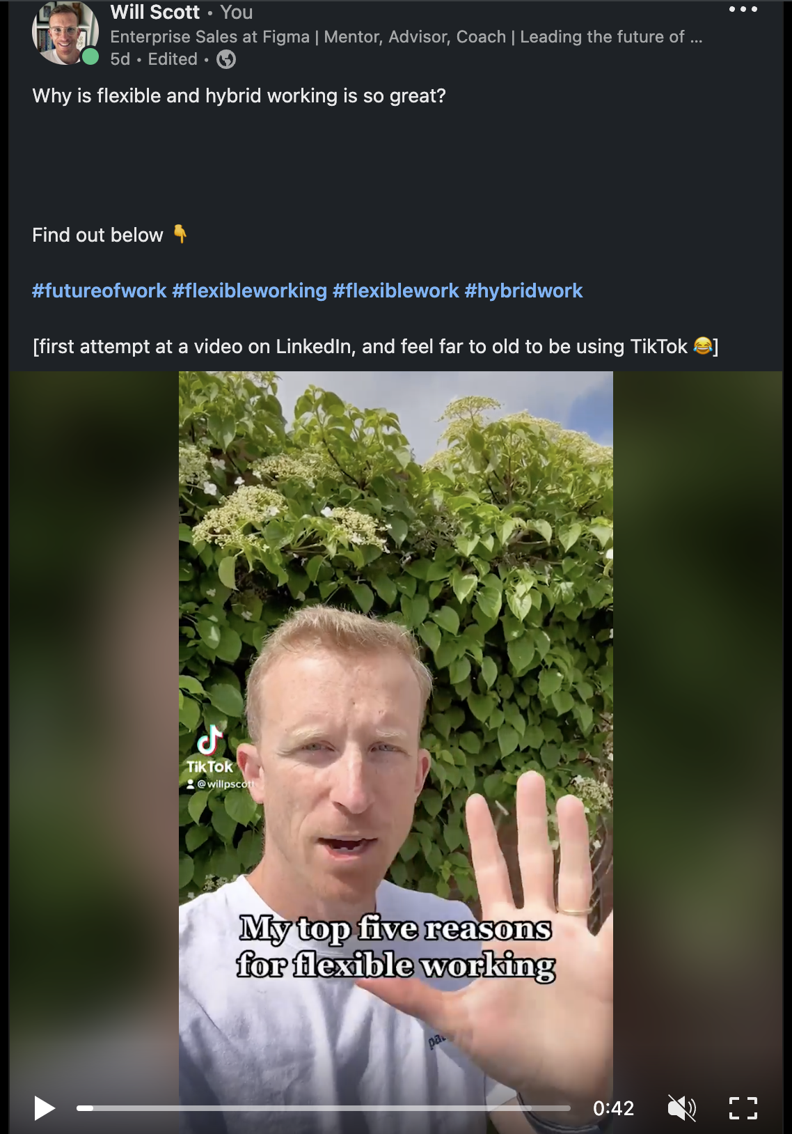
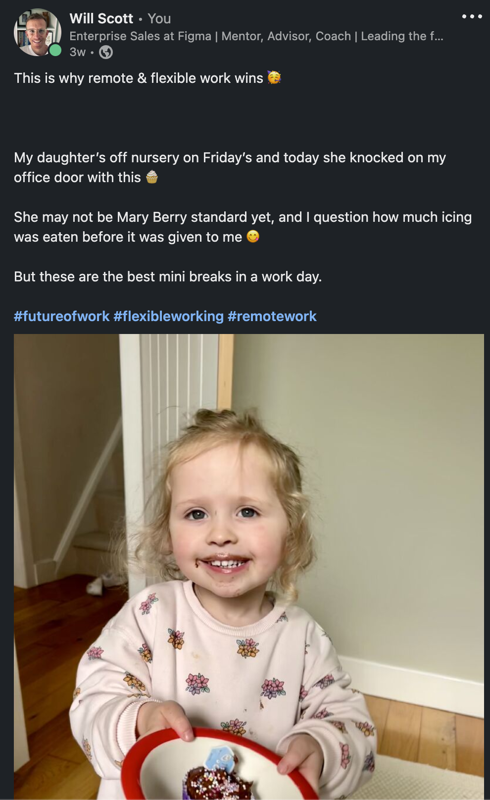
Building your brand on LinkedIn

Slide 9

Why build your brand?
Notes:
Who remembers this guy?

Slide 10
Why build your brand?
People will remember you
It fuels your creativity
It gives you a goal
It opens doors 🚪
Interviews, job offers, freelance work, investment opportunities, mentorship, speaking opportunities, new business, friendships + more!

Slide 11
Posting best practices
Find a topic you’re passionate about
Stick to a structure
Use hashtags - but not too many, this isn’t Twitter circa 2010
Mix it up - formats, lengths, topics (particularly at the start)
Don’t focus on the numbers - sometimes the algorithm makes no sense!

Slide 12

Thank you!
Any questions?
Connect with me 👉

Slide 13
A challenge to finish!
Put what you’ve heard into practice over the next few weeks…
1️⃣ Connect with everyone here
2️⃣ Spend 15-20 minutes on your profile
3️⃣ Post 1x week, building up to 3x per week by the end of the month
4️⃣ Comment on posts - 1x day, building up to 3-5x per day
Let me know how you get on!

